Slide 1


IBM Data Science Capstone Project
Space X Falcon 9 Landing Analysis
GitHub link: https://github.com/saudsayyad/Applied_Data_Science_Capstone.git

Slide 2
01 Executive Summary 02 Introduction 03 Methodology 04 Results 05 Conclusion 06 Appendix
Table of contents

Slide 3
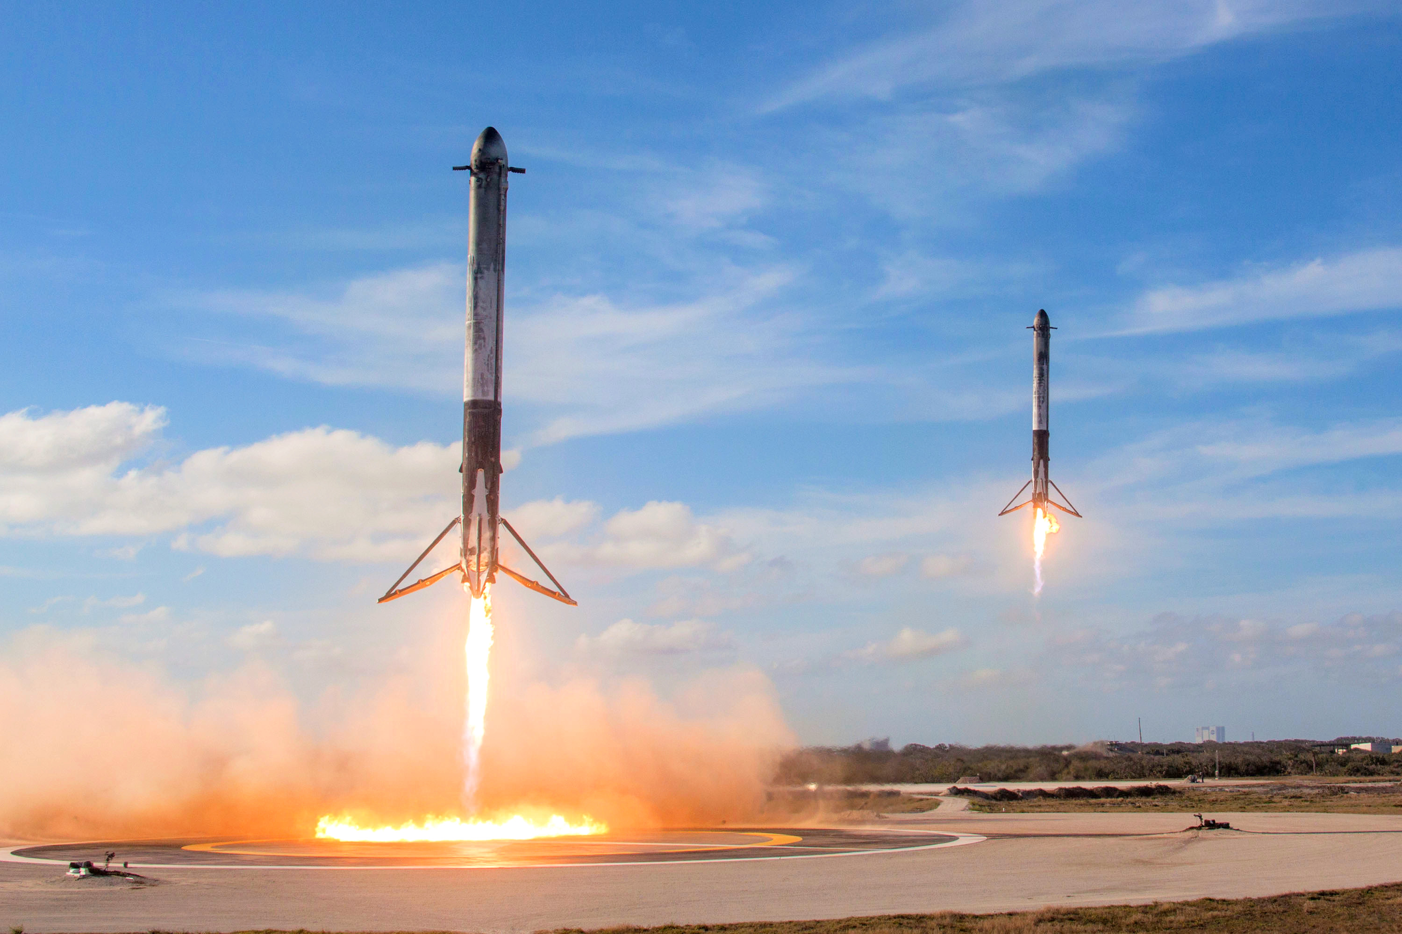
Executive Summary
Summary of Methodologies:
This project follows thee steps:
Data Collection
Data Wrangling
Exploratory Data Analysis
Interactive Visual Analytics
Predictive Analysis (Classification)
Summary of Results:
This project produced the following outputs and visualizations:
Exploratory Data Analysis (EDA) results
Geospatial Analytics
Interactive Dashboard
Predictive Analysis of classification models

Slide 4
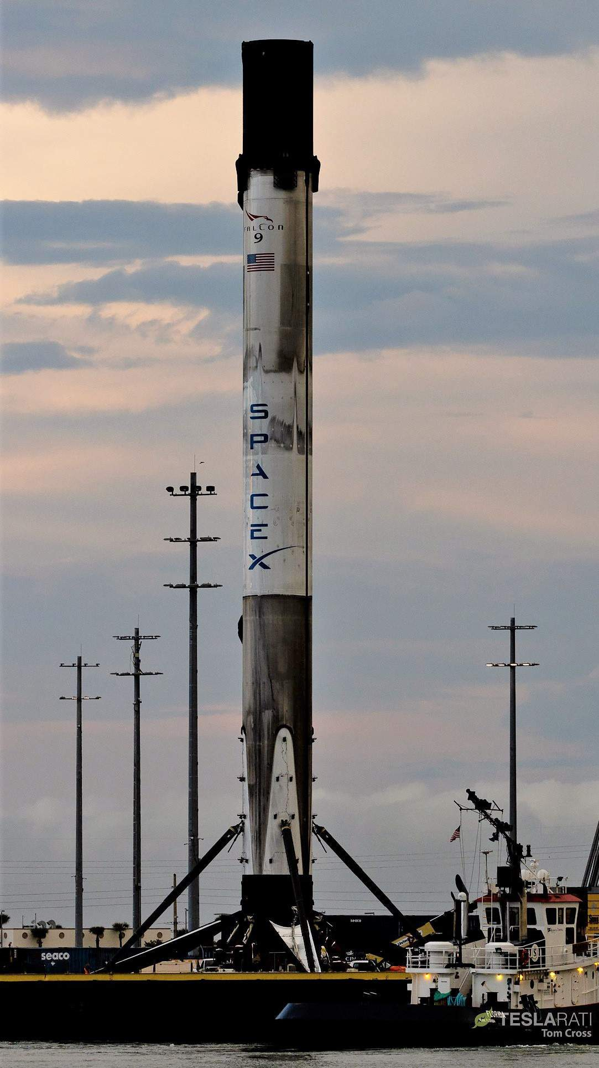
Introduction
SpaceX launches Falcon 9 rocket at a cost of 62 million dollars. This is considerably cheaper than other providers (which usually cost upwards of $165m), and much of the savings are because SpaceX can land, and then re-use the first stage of the rocket.
If we can make predictions on whether the first stage will land ,we can determine the cost of a launch. And use this information to asses whether or not an alternate company should bid and SpaceX for a rocket launch.
This project will ultimately predict if the SpaceX Falcon 9 first stage will land successfully.

Slide 5
Methodology Summary
Data Collection
Making GET requests to the SpaceX REST API
Web Scrapping
Data Wrangling
Using the .fillna() method to remove NaN values
Using the .value_counts() method to determine number of occurrences of values.
Creating a landing outcome label that shows 0 on failed landings and 1 on successful landings.
Exploratory Data Analysis
Using SQL queries to manipulate and evaluate the SpaceX dataset
Using Pandas and Matplotlib to visualize relationship between variables, and determine patterns.
Interactive Visual Analytics
Geospatial Analytics using Folium
Creating an interactive dashboard using Plotly Dash.
Data Modelling and Evaluation
Using Scikit-Learn to:
Standardize the data
Split the data into training and testing data using train_test_split
Train different classification models
Find Hyperparameters using GridSearchCV
Plotting confusion matrices for each classification model.
Assessing the accuracy of each classification model.

Slide 6
Data Collection
The data was collected using various methods
Data collection was done using get request to the SpaceX API.
Next, we decoded the response content as a Json using .json() function call and turn it into a pandas DataFrame using .json_normalize().
We then cleaned the data, checked for missing values and fill in missing values where necessary.
In addition, we performed web scraping from Wikipedia for Falcon 9 launch records with BeautifulSoup.
The objective was to extract the launch records as HTML table, parse the table and convert it to a pandas dataframe for future analysis.

Slide 7
Data Collection – SpaceX Rest API
Using the SpaceX API to retrieve data about launches, including information about the rocket used, payload delivered, launch specifications, landing specifications, and landing outcome.
Make a GET response to the SpaceX REST API
Convert the response to a .json file then to a Pandas DataFrame
Use custom logic to clean the data (see Appendix)
Define lists for data to be stored in
Call custom functions (see Appendix) to retrieve data and fill the lists
Use these lists as values in a dictionary and construct the dataset
Create a Pandas DataFrame from the constructed dictionary dataset
Filter the DataFrame to only include Falcon 9 launches
Reset the FlightNumber column
Replace missing values of PayloadMass with the mean PayloadMass value

Slide 8
Data Collection – Web Scraping
Web scraping to collect Falcon 9 historical launch records from a Wikipedia page titled List of Falcon 9 and Falcon Heavy launches. Data collection was done using get request to the SpaceX API.
Request the HTML page from the static URL
Assign the response to an object
Create a BeatifulSoup object from the response object
Find all tables within the HTML page
Collect all column headers from the table.
Use the column names as keys in the dictionary
Convert the dictionary to a Pandas DataFrame and export csv file created from DataFrame.

Slide 9
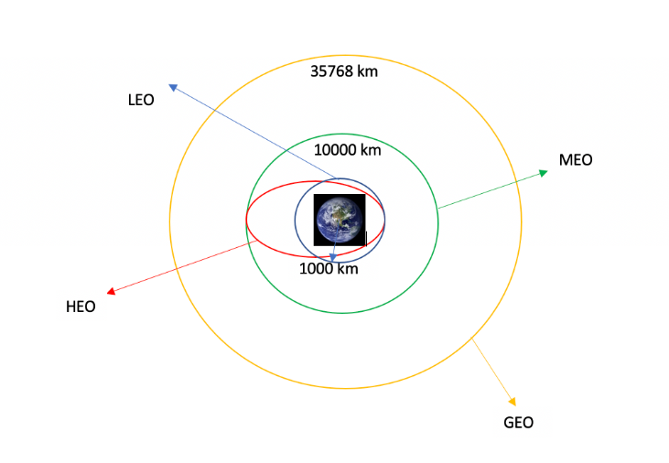
Data Wrangling
The SpaceX dataset contains several launch facilities.
Each launch aims to a dedicated orbit, and some of the common orbit types are shown in the figure below. The orbit type is in the Orbit column.
We performed exploratory data analysis and determined the training labels.
We calculated the number of launches at each site, and the number and occurrence of each orbits.
We created landing outcome label from outcome column and exported the result to csv.

Slide 10
EDA with Data Visualization
Scatter Plot
Scatter Plot were produced to visualize the relationship between:
Flight Number and Launch Site
Payload and Launch Site
Orbit type and Flight Number
Payload and Orbit Type
Bar Chart
Bar Charts were produced to visualize the relationship between:
Success Rate and Orbit Type
Line Chart
Line charts were produced to visualize the relationship between:
Success Rate and Year (Launch Success Year Trend)
Line charts contain numerical values on both axes and generally used to show the change of a variable over time.
Bar Charts are used to compare numerical value to a categorical variable.

Slide 11
EDA with SQL
The SQL queries performed on the data set were used to:
Display the names of the unique launch sites in the space mission
Display 5 records where launch sites begin with the string ‘CCA’
Display the total payload mass carried by boosters launched by NASA (CRS)
Display the average payload mass carried by booster version F9 v1.1
List the date when the first successful landing outcome on a ground pad was achieved
List the names of the boosters which had success on a drone ship and a payload mass between 4000 and 6000 kg
List the total number of successful and failed mission outcomes
List the names of the booster versions which have carried the maximum payload mass
List the failed landing outcomes on drone ships, their booster versions, and launch site names for 2015
Rank the count of landing outcomes (such as Failure (drone ship) or Success (ground pad)) between the date 2010-06-04 and 2017-03-20, in descending order

Slide 12
Build an Interactive Map with Folium
The following steps were taken to visualize the launch data on an interactive map:
Mark all launch sites on a map
Initialize the map using a Folium Map object
Add a folium.Circle and folium.Marker for each launch site on the launch map
Mark the success/failed launches for each site on a map
As many launches have the same coordinates, it makes sense to cluster them together.
Before clustering them, assign a marker colour of successful (class = 1) as green, and failed (class = 0) as red.
To put the launches into clusters, for each launch, add a folium.Marker to the MarkerCluster()object.
Create an icon as a text label, assigning the icon_color as the marker_colour determined previously.

Slide 13
Build a Dashboard with Plotly Dash
The following plots were added to a Plotly Dash dashboard to have an interactive visualization of the data:
Pie chart showing the total successful launches per site
This makes it clear to see which sites are most successful
The chart could also be filtered to see the success/failure ratio for an individual site.
Scatter graph to show the correlation between outcome (success or not) and payload mass (kg)
This could be filtered by ranges of payload masses
It could also be filtered by booster version

Slide 14
Predictive Analysis (Classification)
Model Development
Load dataset
Perform necessary data transformations (standardise and pre-process)
Split data into training and test data sets, using train_test_split()
Decide which type of machine learning algorithms are most appropriate
Create a GridSearchCV object and a dictionary of parameters
Fit the object to the parameters
Use the training data set to train the model
Model Evaluation
For each chosen algorithm:
Check the tuned hyperparameters (best_params_)
Check the accuracy (score and best_score_)
Plot and examine the Confusion Matrix

Slide 15
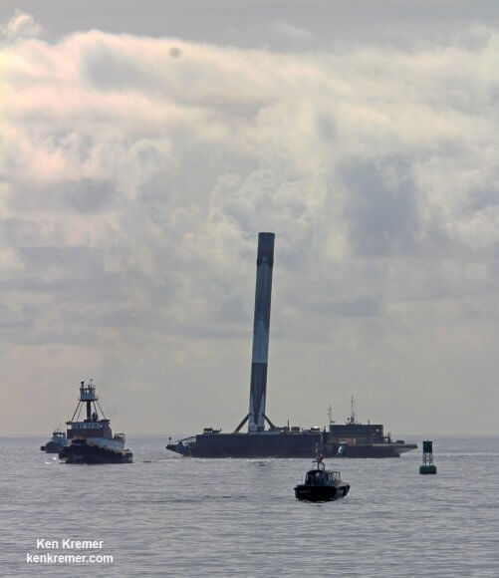
Results
Exploratory Data Analysis
Interactive Analytics
Predictive Analysis
This Photo by Unknown Author is licensed under CC BY

Slide 16
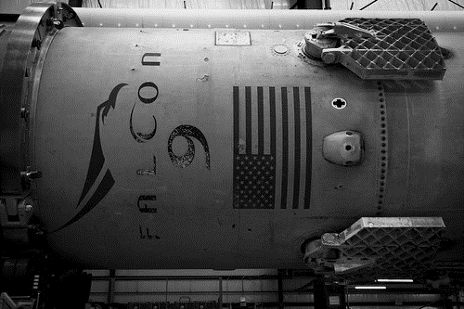
EDA – With Visualization

Slide 17
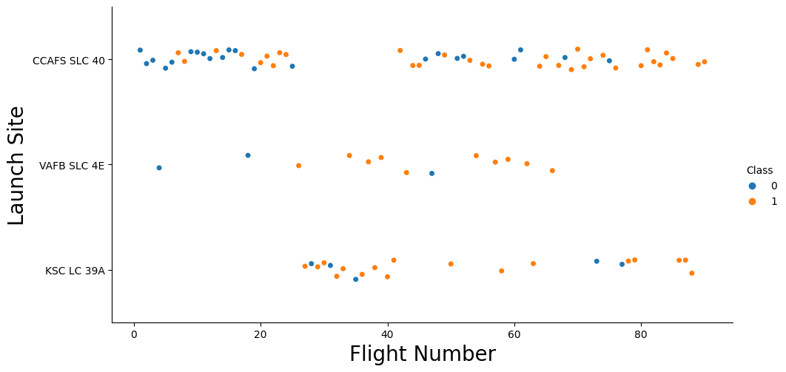
Flight Number vs. Launch Site
As the number of flights increases, the rate of success at a launch site increases.
Most of the early flights (flight numbers < 30) were launched from CCAFS SLC 40, and were generally unsuccessful.
The flights from VAFB SLC 4E also show this trend, that earlier flights were less successful.
No early flights were launched from KSC LC 39A, so the launches from this site are more successful.
Above a flight number of around 30, there are significantly more successful landings (Class = 1).

Slide 18
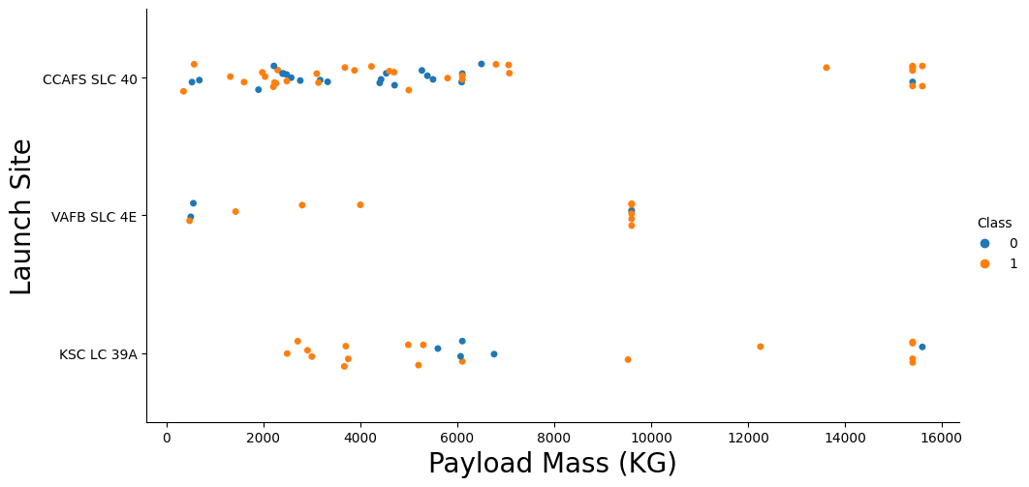
Payload vs. Launch Site
Above the payload mass of around 7000 kg, there are very few unsuccessful landings, but there is also far less data for these heavier launches.
There is no clear correlation between payload mass and success rate for a given launch site.
All sites launched a variety of payload masses, with most of the launches from CCAFS SLC 40 being comparatively lighter payloads (with some outliers).

Slide 19
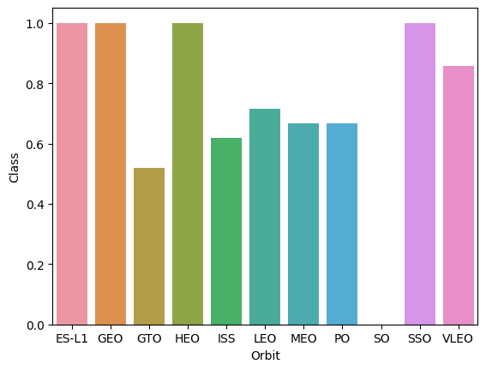
Success Rate vs. Orbit Type
The bar chart of Success Rate vs. Orbit Type shows that the following orbits have the highest (100%) success rate:
ES-L1(Earth-Sun First Lagrangian Point)
GEO (Geostationary Orbit)
HEO (High Earth Orbit)
SSO (Sun-synchronous Orbit)
The orbit with the lowest (0%) success rate is:
SO (Heliocentric Orbit)

Slide 20
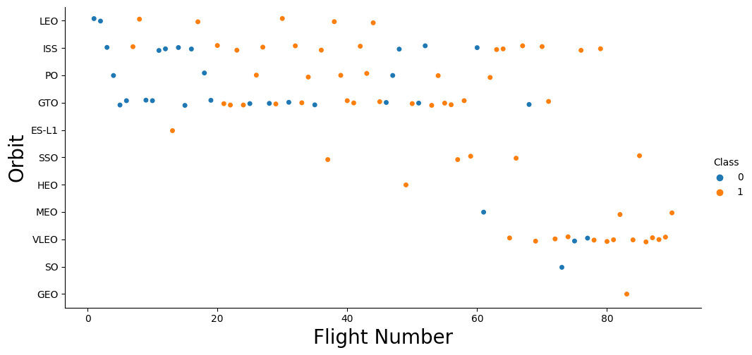
Flight Number vs. Orbit Type
This scatter plot of Orbit Type vs. Flight number shows a few useful things that the previous plots did not, such as:
The 100% success rate of GEO, HEO, and ES-L1 orbits can be explained by only having 1 flight into the respective orbits.
The 100% success rate in SSO is more impressive, with 5 successful flights.
Generally, as Flight Number increases, the success rate increases. This is most extreme for LEO, where unsuccessful landings only occurred for the low flight numbers (early launches).

Slide 21
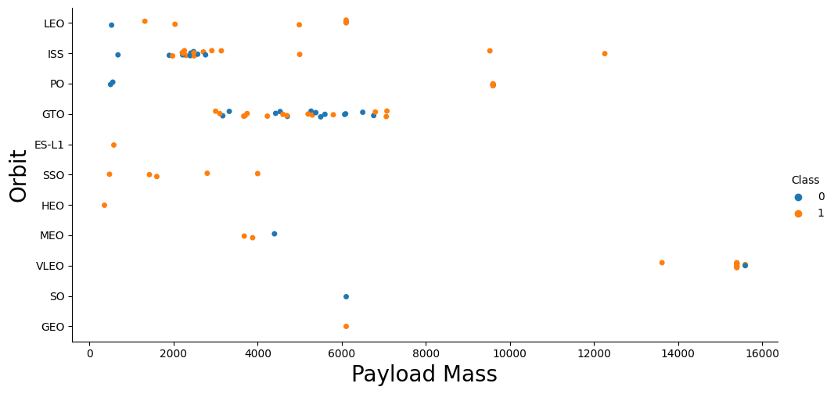
Payload vs. Orbit Type
This scatter plot of Orbit Type vs. Payload Mass shows that:
The following orbit types have more success with heavy payloads:
•PO
•ISS
•LEO
For GTO, the relationship between payload mass and success rate is unclear.
VLEO (Very Low Earth Orbit) launches are associated with heavier payloads, which makes intuitive sense.

Slide 22
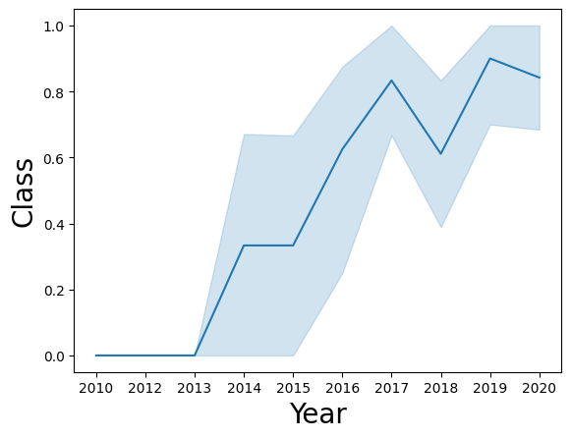
Launch Success Yearly Trend
The line chart of yearly average success rate shows that:
Between 2010 and 2013, all landings were unsuccessful (as the success rate is 0).
After 2013, the success rate generally increased, despite small dips in 2018 and 2020.
After 2016, there was always a greater than 50% chance of success.

Slide 23
EDA – With SQL

Slide 24
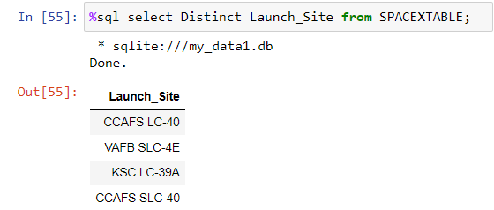
All Launch Site Names
The keyword Distinct returns all unique/Distinct values from Launch Site column.

Slide 25
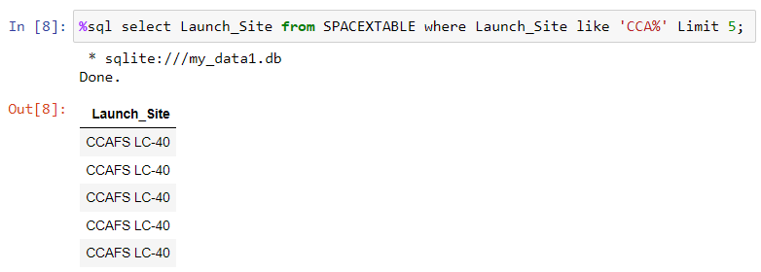
Launch Site Names Begin with ‘CCA’
Where clause use to add condition in queries while LIMIT 5 fetches only 5 record and Like is used with a wildcard to retrieve values starting with ‘CCA’

Slide 26
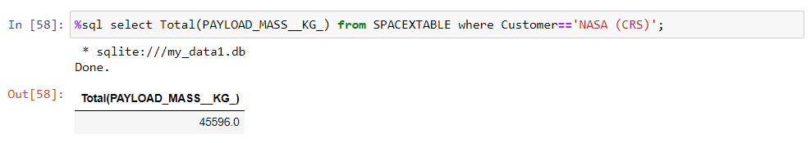
Total Payload Mass
The Total is used to calculate the total of Payload Mass. While where used to filter the results.

Slide 27
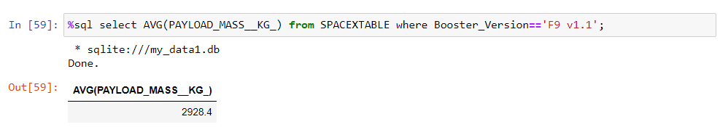
Average Payload Mass by F9 v1. 1
The keyword AVG is used to calculate the average of the Payload_Mass_KG_ column and WHERE is used to filter results for Booster Version F9 v1.1.

Slide 28
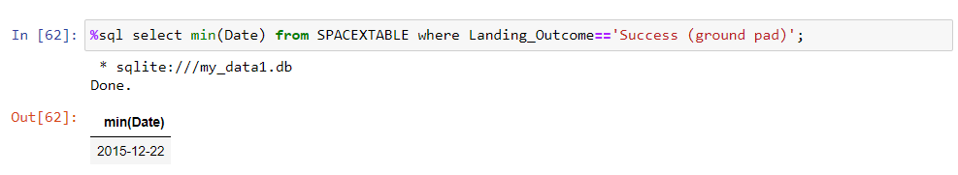
First Successful Ground Landing Date
The MIN keyword is used to calculate the minimum of the DATE column, i.e. the first date, and the WHERE keyword (and the associated condition) filters the results to only the successful ground pad landings.

Slide 29
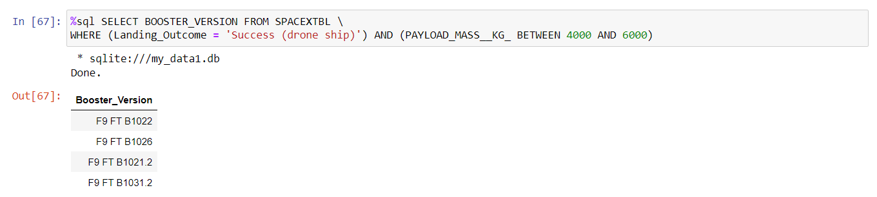
Successful Drone Ship Landing with Payload between 4000 and 6000
The WHERE keyword is used to filter the results to include only those that satisfy both conditions in the brackets (as the AND keyword is also used). The BETWEEN keyword allows for 4000 < x < 6000 values to be selected.

Slide 30
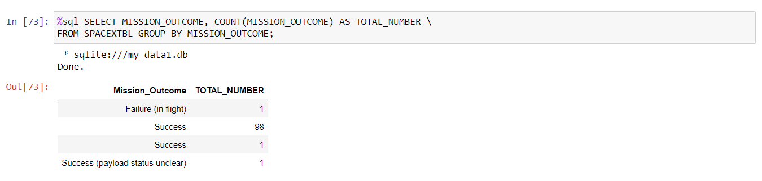
Total Number of Successful and Failure Mission Outcomes
The COUNT keyword is used to calculate the total number of mission outcomes, and the GROUPBY keyword is also used to group these results by the type of mission outcome.

Slide 31
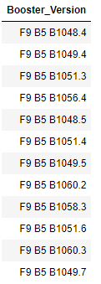
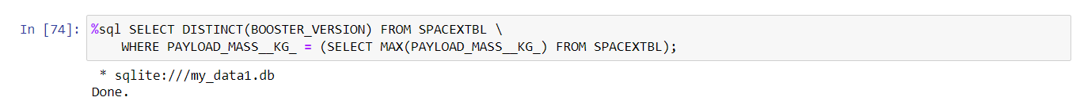
Boosters Carried Maximum Payload
A subquery is used here. The SELECT statement within the brackets finds the maximum payload, and this value is used in the WHERE condition. The DISTINCT keyword is then used to retrieve only distinct /unique booster versions.

Slide 32
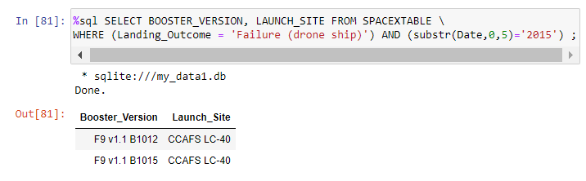
2015 Launch Records
The WHERE keyword is used to filter the results to include only failed landing outcomes, AND is used to combine two conditions.

Slide 33
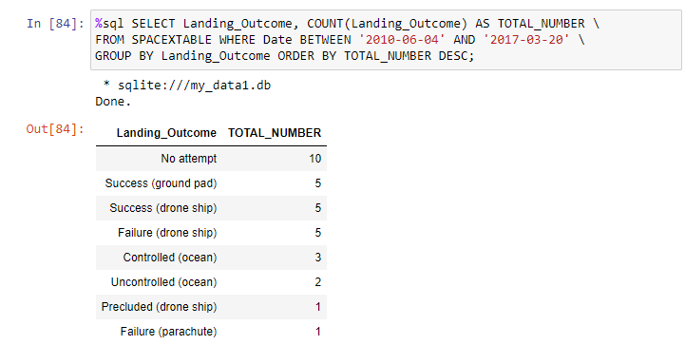
Rank Landing Outcomes Between 2010-06-04 and 2017-03-20
The WHERE keyword is used with the BETWEEN keyword to filter the results to dates only within those specified. The results are then grouped and ordered, using the keywords GROUP BY and ORDER BY, respectively, where DESC is used to specify the descending order.

Slide 34
Launch Sites Proximity Analysis – Folium Interactive Map

Slide 35
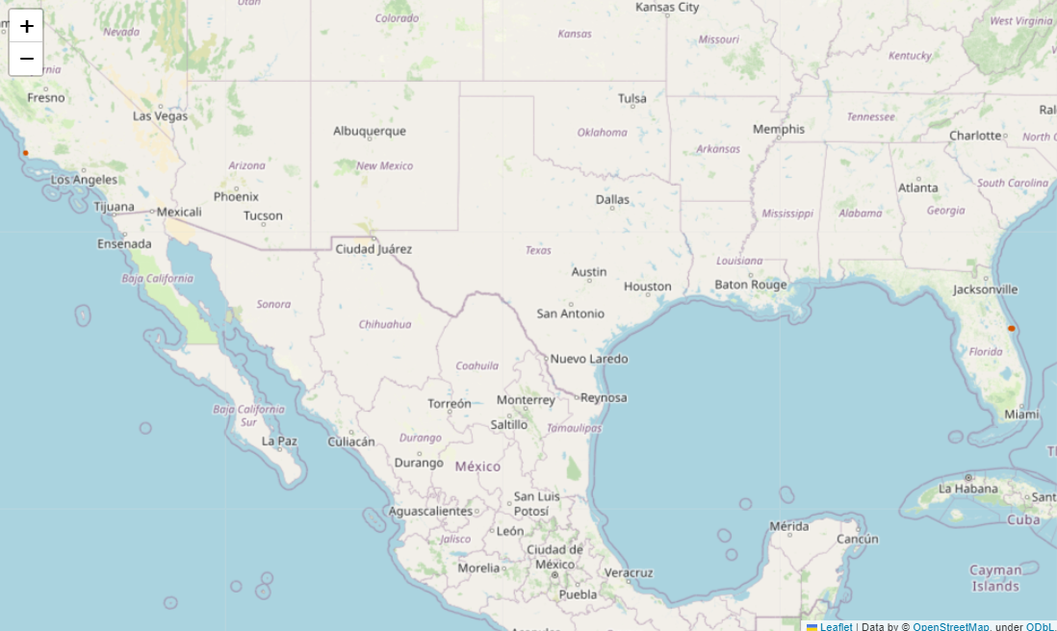
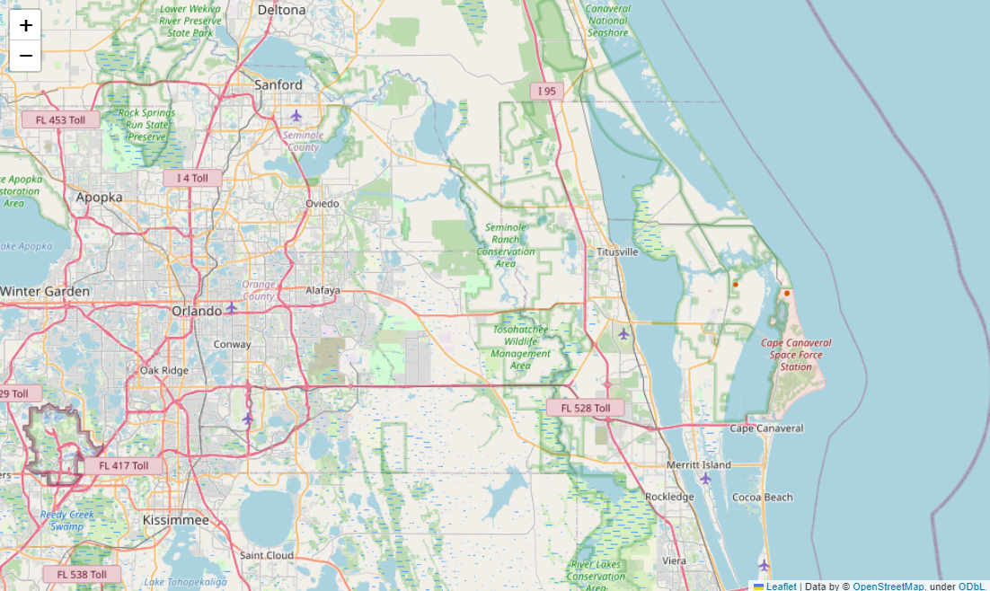
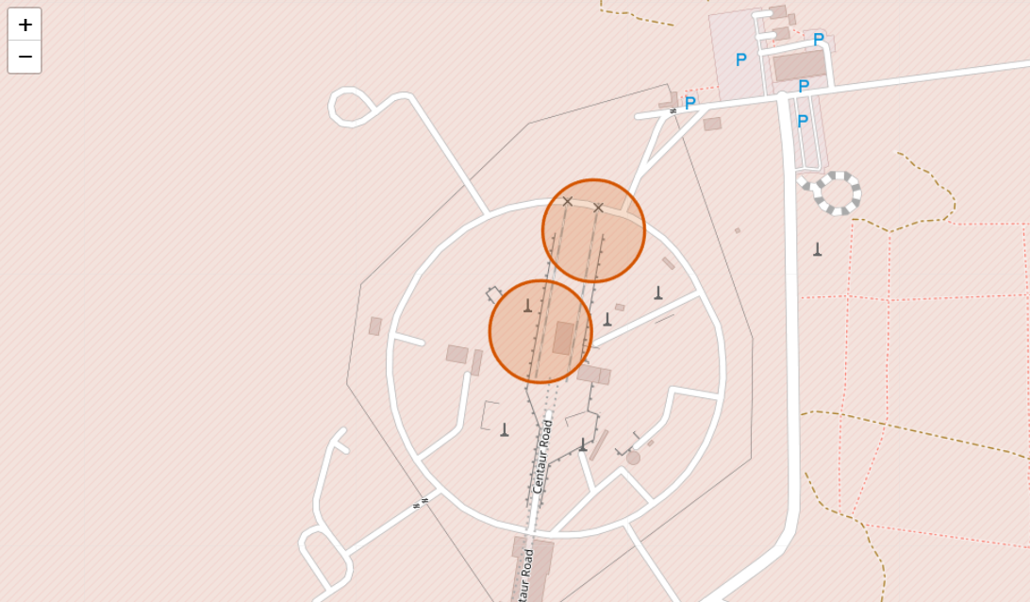
Marking All Launch Sites on Map
All SpaceX launch site are on coasts of the United States of America, Specifically on east coast.

Slide 36
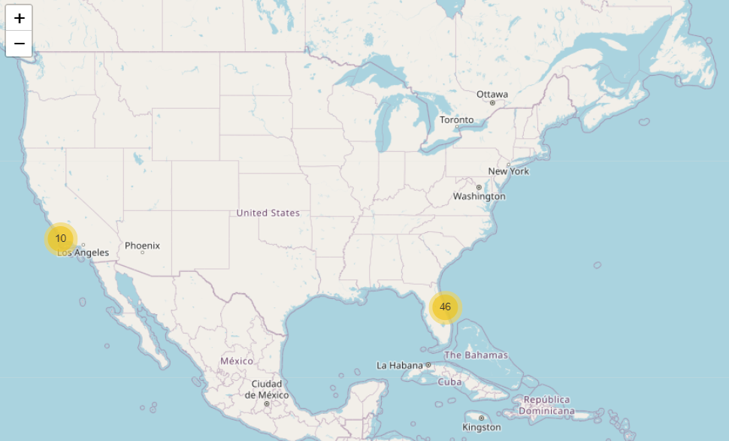
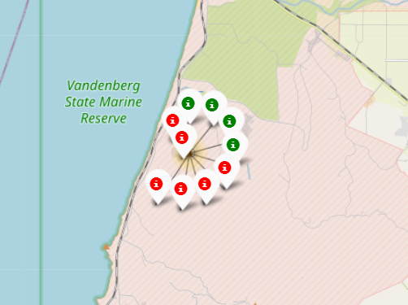
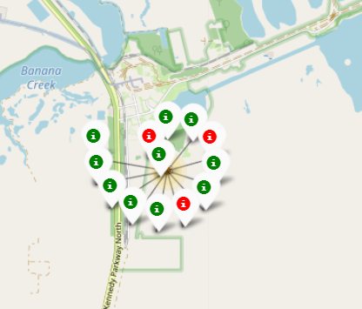
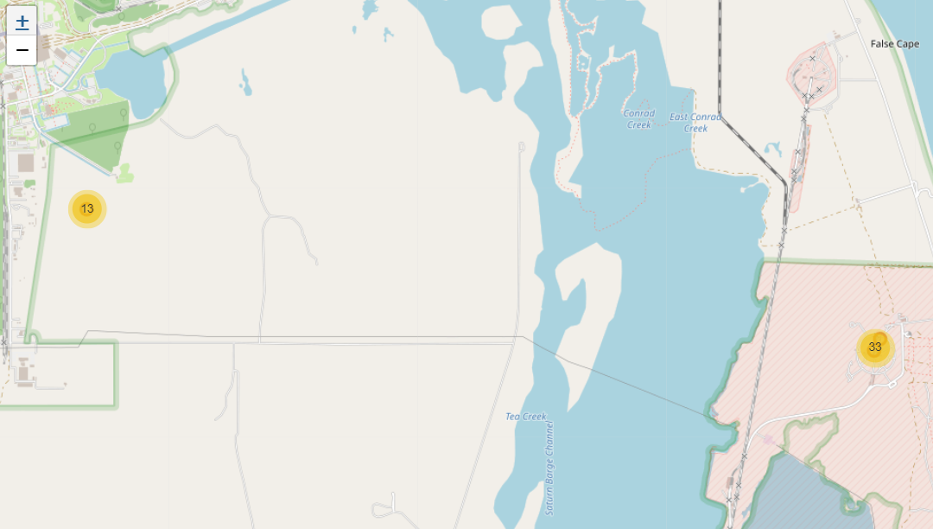
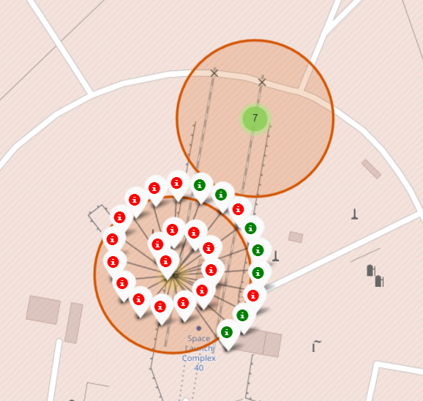
Success/Failed Launch on each site
Launches have been grouped into clusters, where green color shows success while red color shows failed launches.
Most of the launches has done in Florida and California.

Slide 37

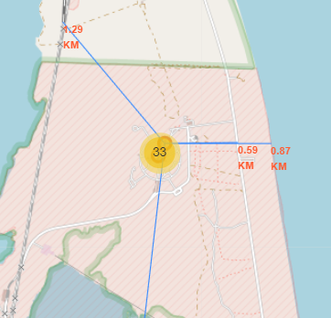
Launch Site Distance to Proximities
Are launch sites in close proximity to railways?
YES. The coast line is only 0.87km due East.
Are launch sites in close proximity to highways?
YES. The nearest highway is only 0.59km away.
Are launch sites in close proximity to railways?
YES. The nearest railway is only 1.29 km away.
Do launch sites keep certain distance away from cities?
YES. The nearest city is 51.74 km away.
We used CCAFS SLC-40 launch site as example from where we can understand of launch sites.

Slide 38
Interactive Dashboard – Plotly Dash

Slide 39
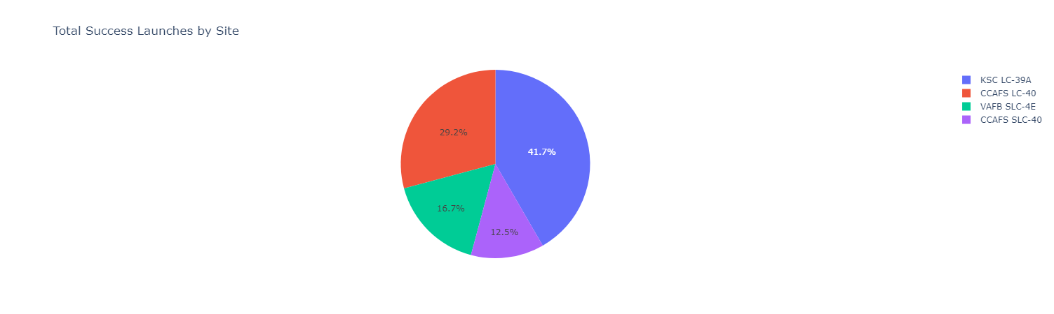
Total Success launches by Site
The launch site KSC LC-39 A had the most successful launches, with 41.7% of the total successful launches.
While launch site CCAFS SLC-40 had the lowest success rate, with 12.5%.

Slide 40
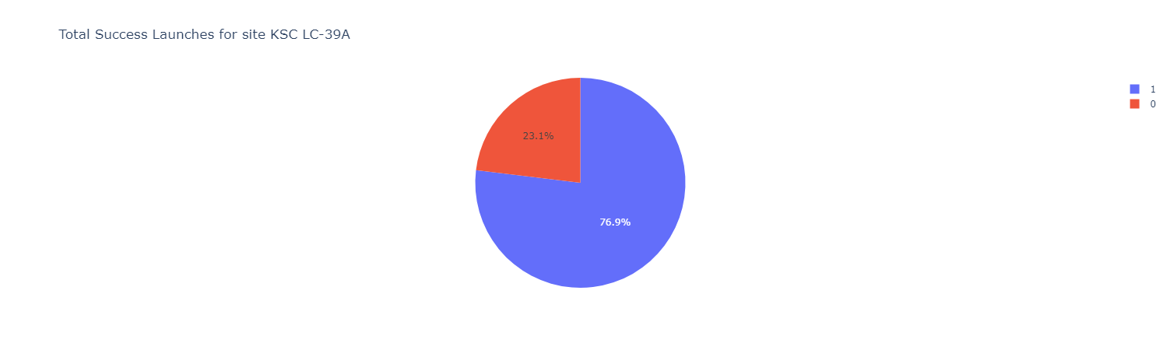
Launch Site with Highest Launch Success Rate
The launch site KSC LC-39 A had the highest rate of successful launches, with a 76.9% success rate.

Slide 41
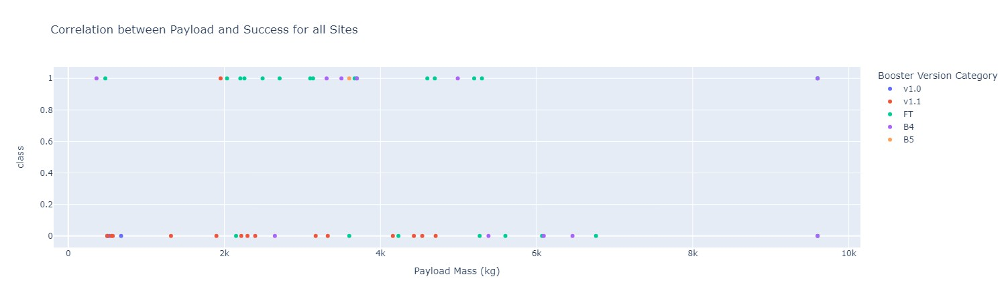
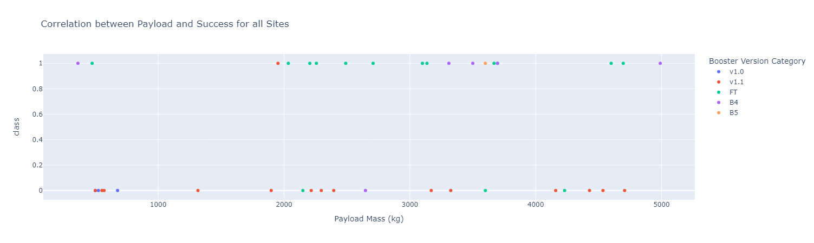
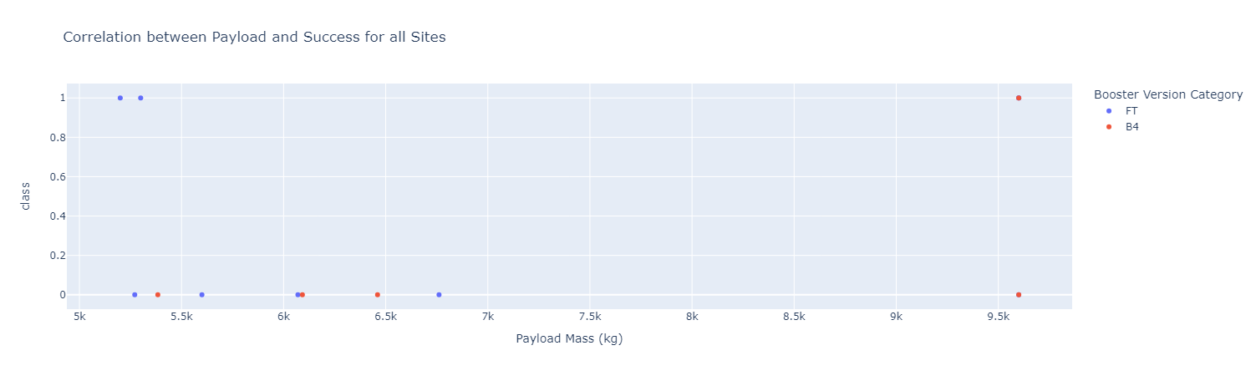
Correlation Between Payload and Success
Plotting the Scatter plot for Payload Mass and Success for different boosters.
Payload can be split into 2 categories
0 – 4000 kg (low payload)
4000 – 10000 kg (Massive Payload)

Slide 42
Predictive Analysis – Classification

Slide 43
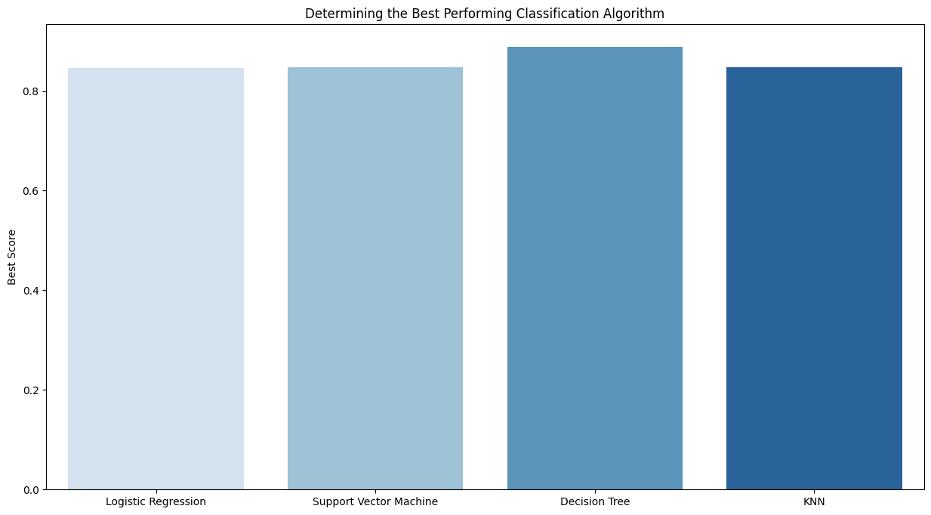
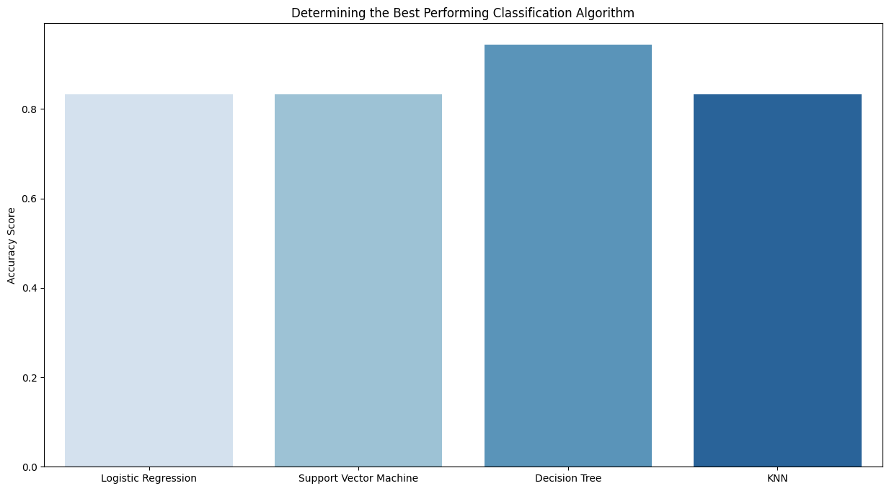
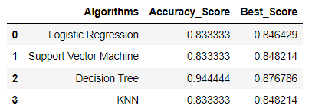
Classification Accuracy
Plotting the Accuracy score and Best Score for each classification algorithm produces the following results:
The Decision Tree model has the highest accuracy score

Slide 44

Confusion Matrix
As shown in previous slide, best Performing classification model is the Decision Tree model, with an accuracy of 94.44%.
This is explained by this confusion matrix, which shows only 1 out of 18 results classified incorrectly.
While other 17 results are correctly classified in which 12 did land successfully and 5 did not land.

Slide 45
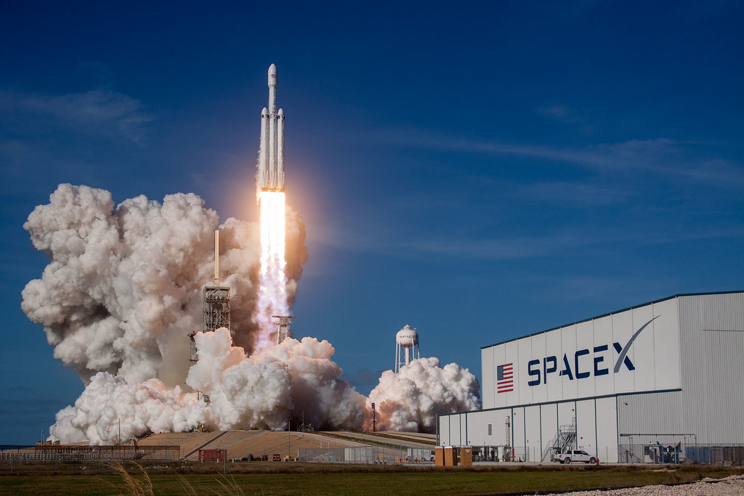
Conclusion

Slide 46
Conclusion
As the number flight increases, the rate of success is also increases, with most early flights being unsuccessful. i.e. with more experience, the success rate increases.
Between 2010 and 2013, all landing were unsuccessful (0% success rate). After 2013, the success rate gradually increased despite small dips in 2018 and 2020.
After 2016 success rate increased to more than 50%.
The launch site KSC LC-39 A had the most successful launches, with 41.7% of the total successful launches, while launch site CCAFS SLC-40 had the lowest success rate, with 12.5%.
The success for massive payloads (over 4000kg) is lower than that for low payloads.
The Best performing classification model is the Decision Tree Model, with an accuracy of 94.4%.

Slide 47

Appendix

Slide 48
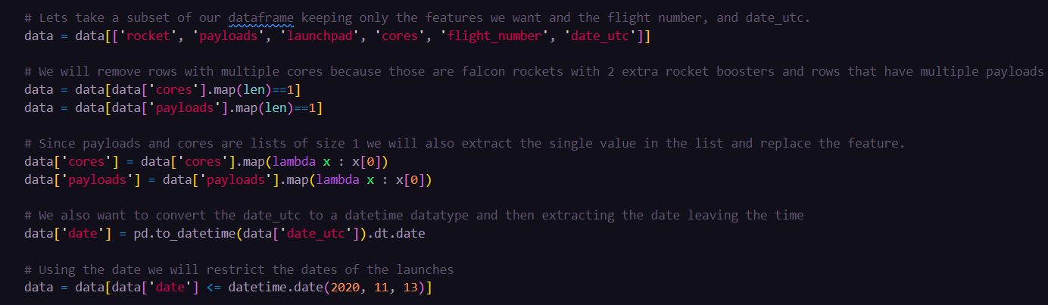

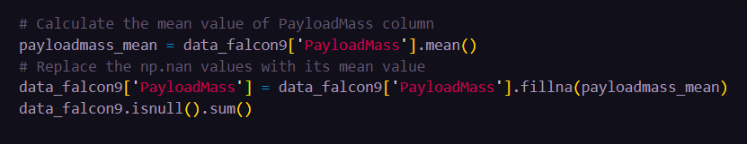
Data Collection - SpaceX REST API
We used the API to get information about the launches using the IDs given for each launch. Specifically used columns rocket, payloads, launchpad, and cores.
Filter the dataframe to only include `Falcon 9` launches
Dealing with missing values by using mean and filling missing values with fillna() method

Slide 49
Thank you !!!

